Slide 1
Cognition data
10 variables, 590 observations

Slide 2

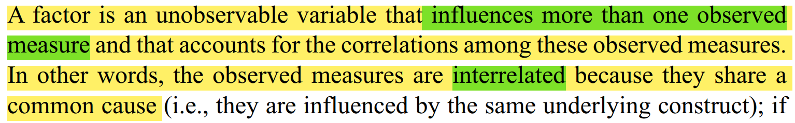
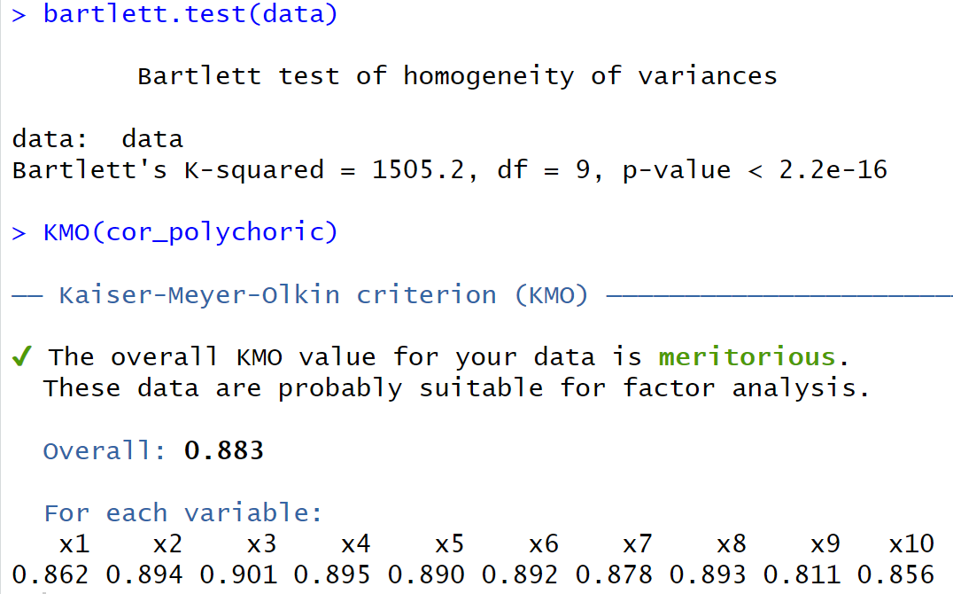
Appropriateness of the Data for EFA

Slide 3
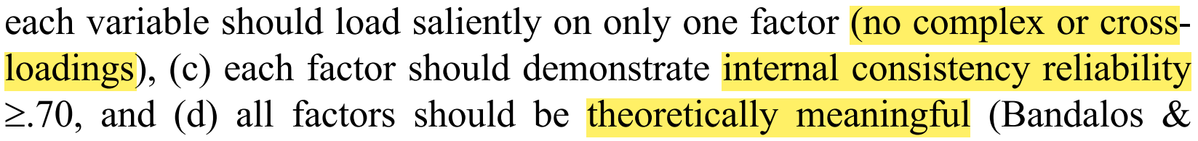
EFA
Matrix of Associations: Polychoric correlation( Ordinal data is assumed to be derived from an underlying continuous distribution)
Method of Factor Extraction: principal axis factoring (PAF, no distributional assumptions)
Factor Retention Rules : Parallel Analysis, Minimum Average Partials( MAP), Very Simple Structure( VSS): 1,2,3
Factor Rotation : orthogonal rotation(the factor axes were maintained at a 90° angle) : varimax
oblique rotation(each axis rotate independent of the other axis): promax and oblimin.

Slide 4
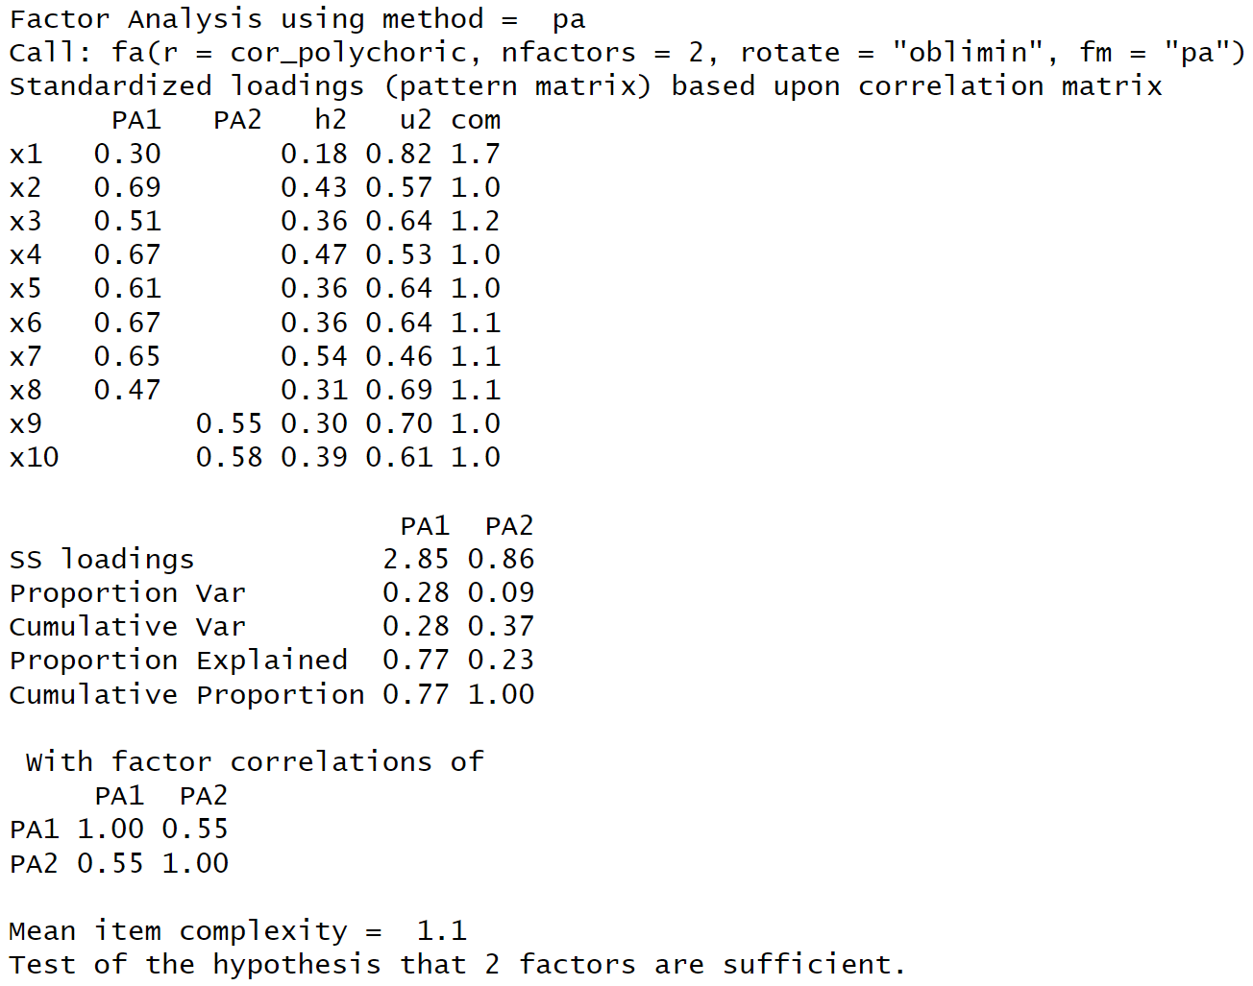
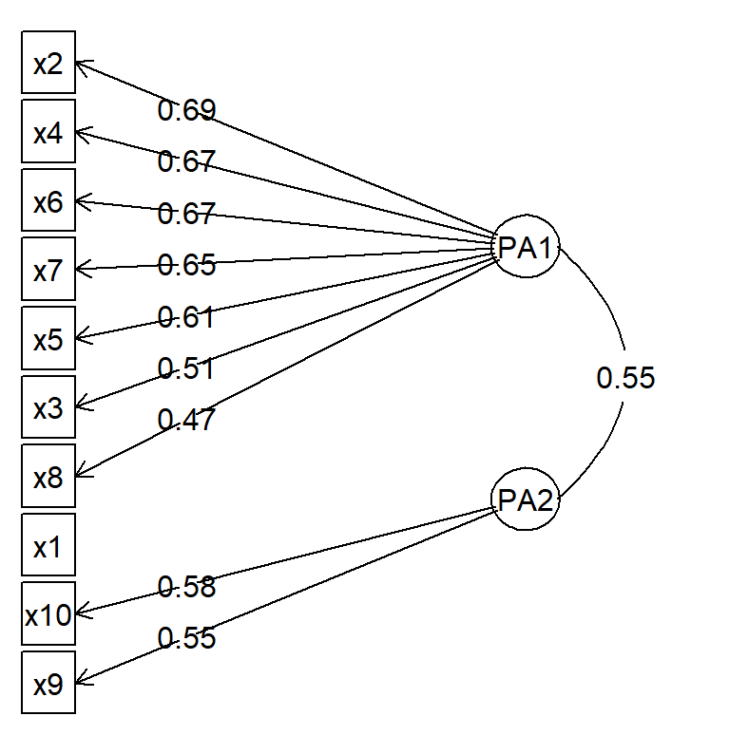

Slide 5
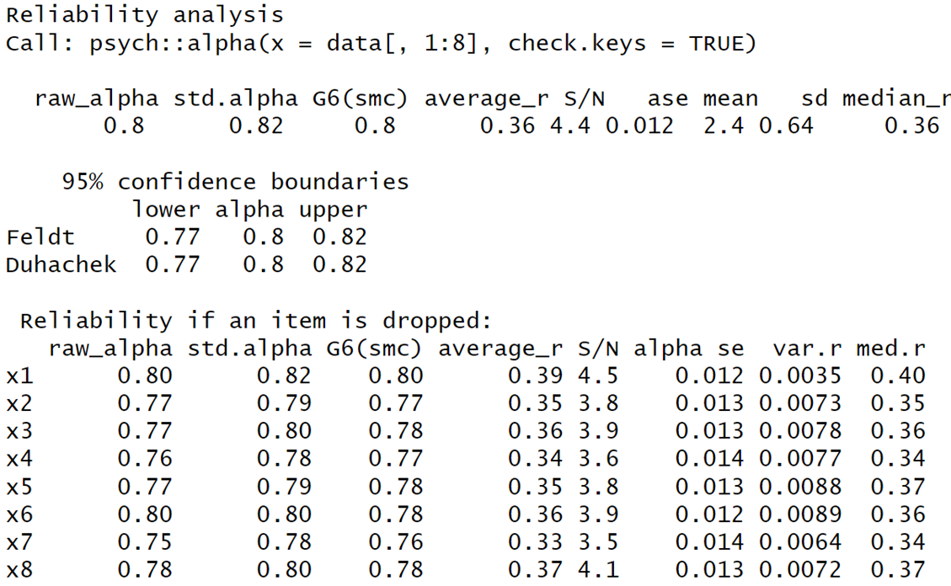
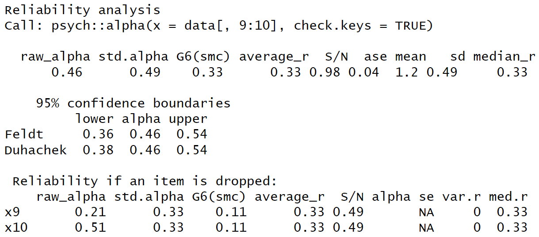


Slide 6
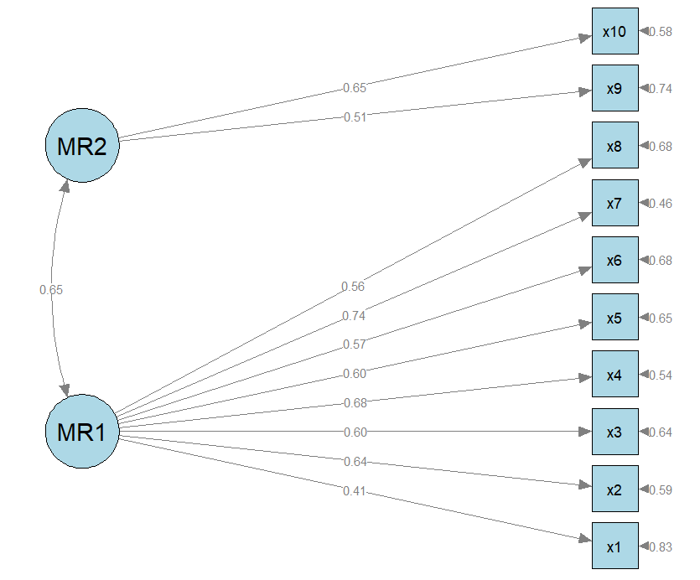
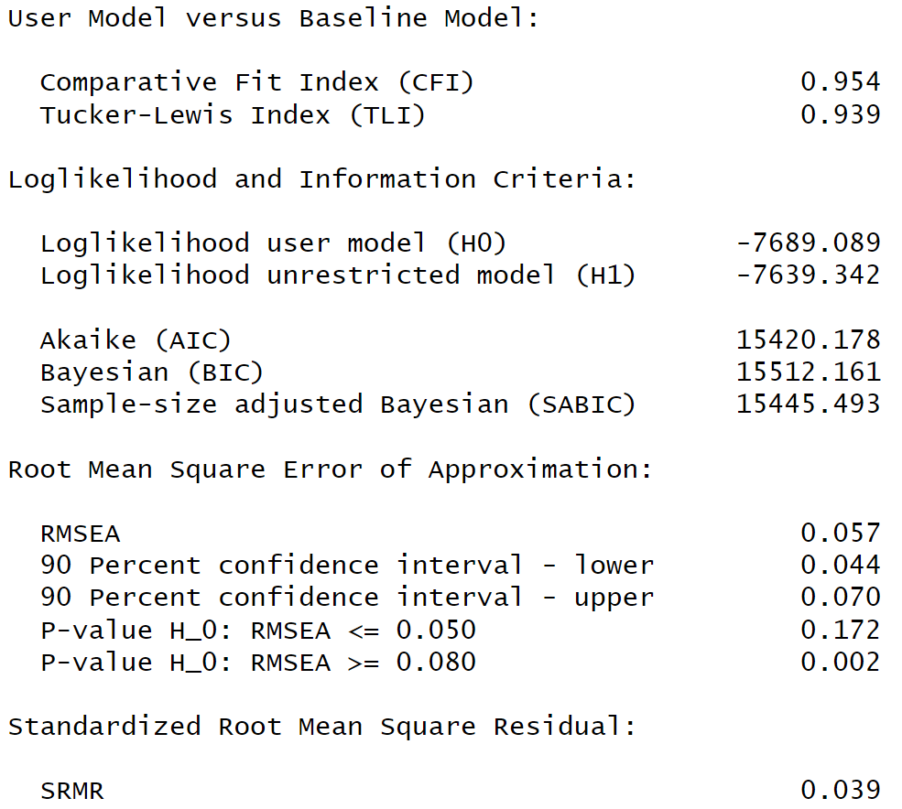
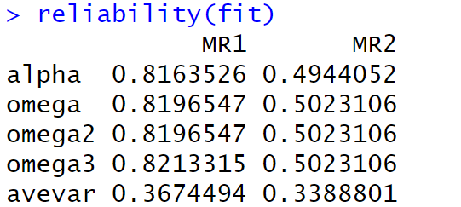
CFA

Slide 7
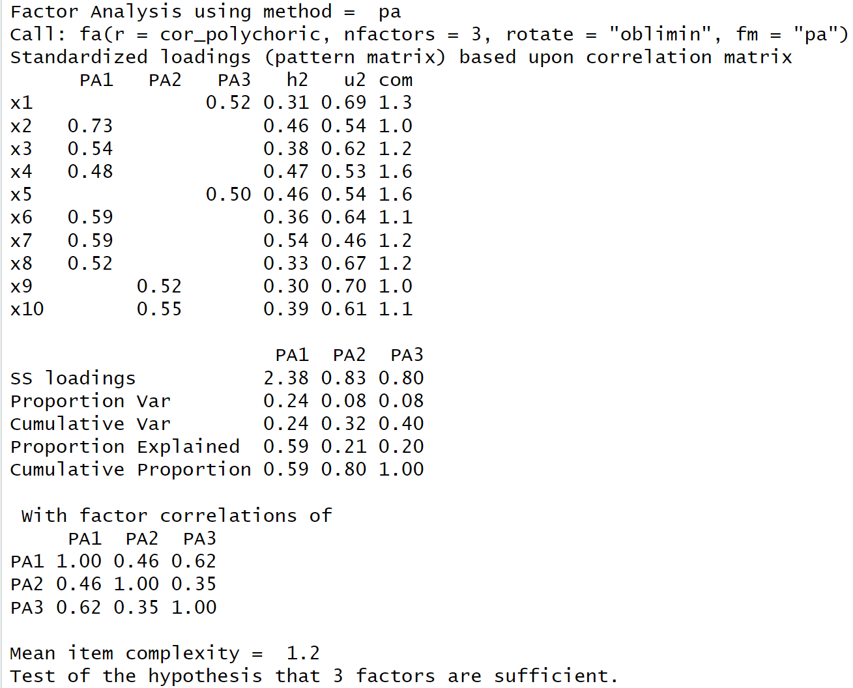
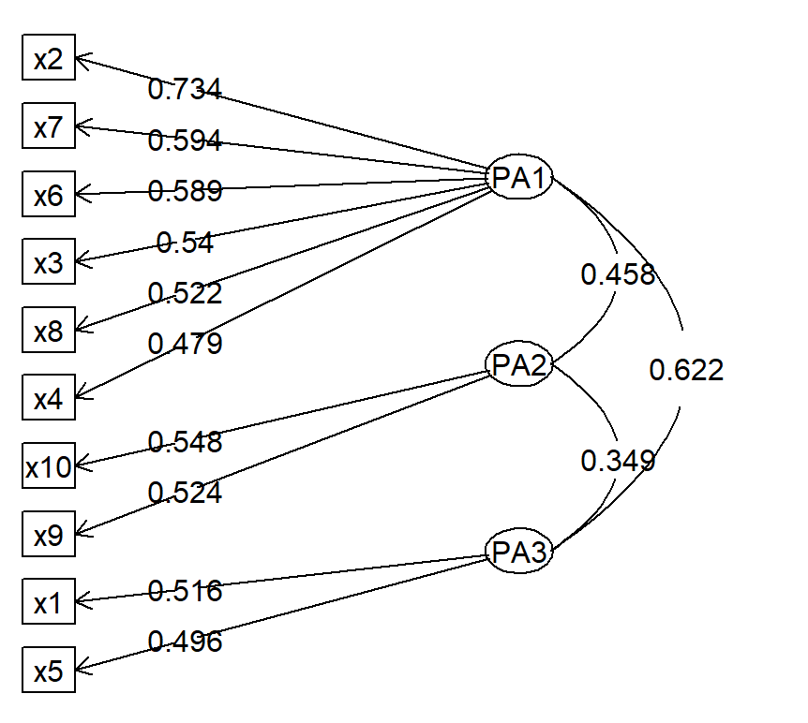

Slide 8
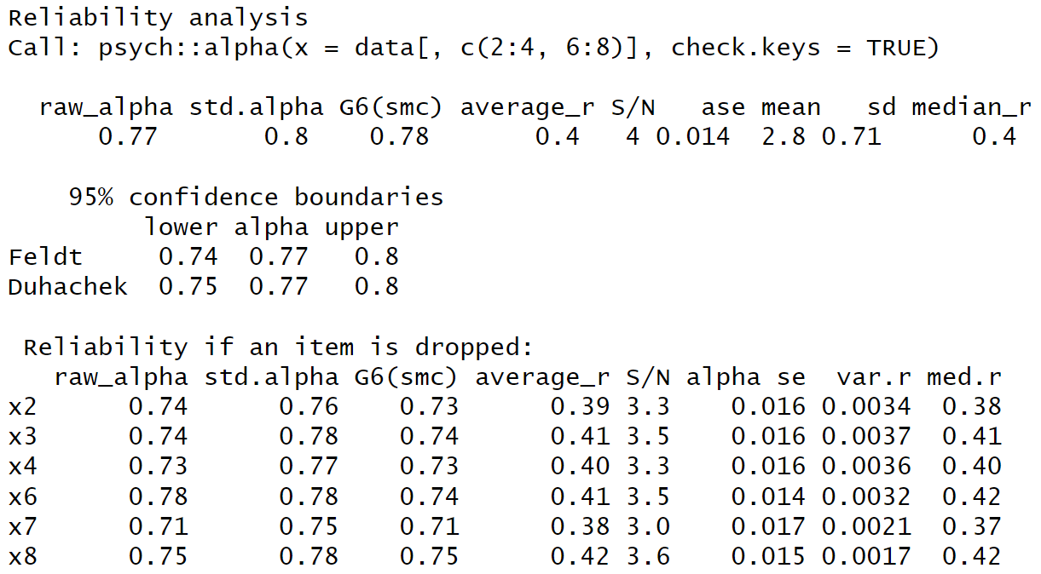
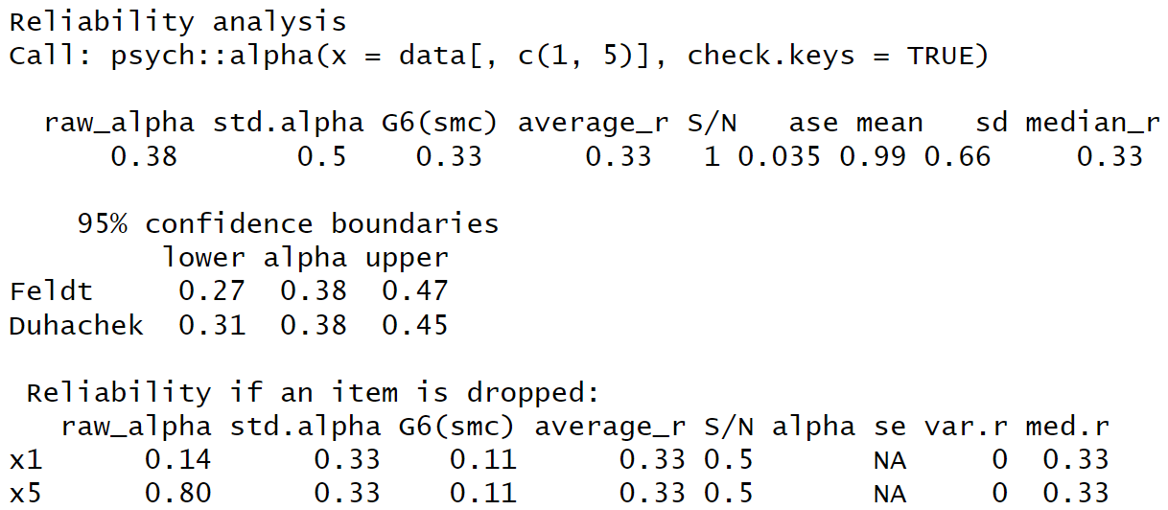


Slide 9
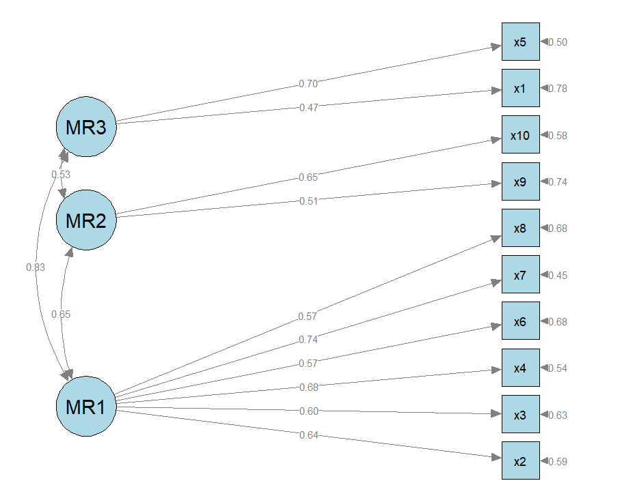
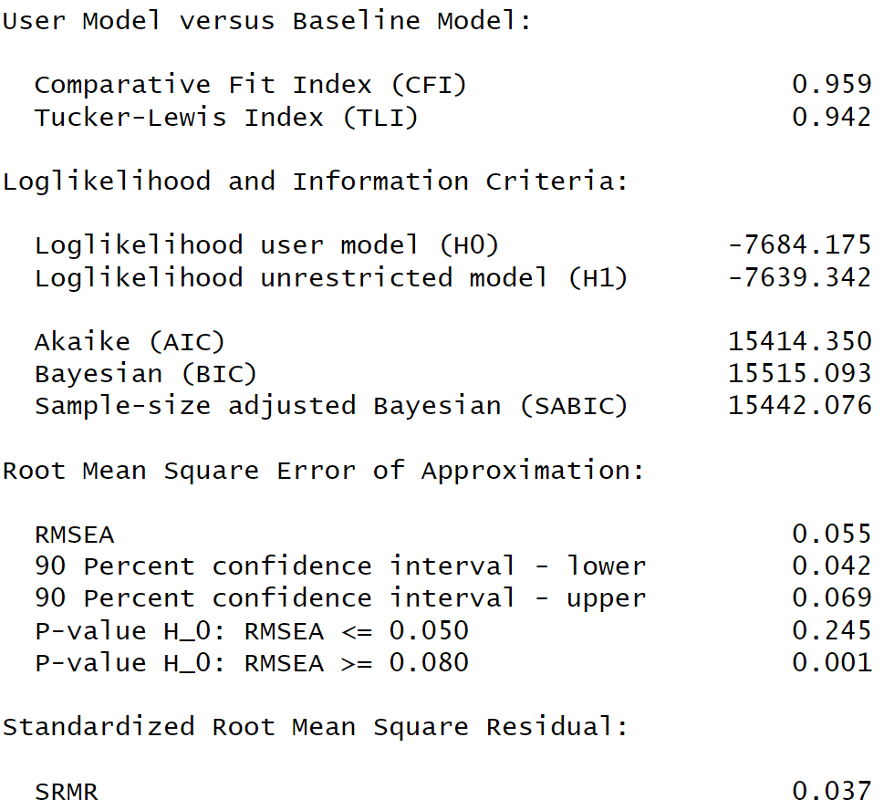
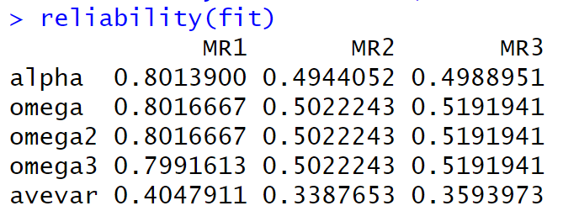


Slide 10
MLE
FOUR APPROACHES: Maximum likelihood method
UMN, “The Underlying Multivariate Normal Approach”, (full information method, not computationally feasible with p > 4 )
NOR, “The Normal Ogive Approach”
POM, “The Proportional Odds Model Approach”
GPCM , “The generalized partial credit model”

Slide 11
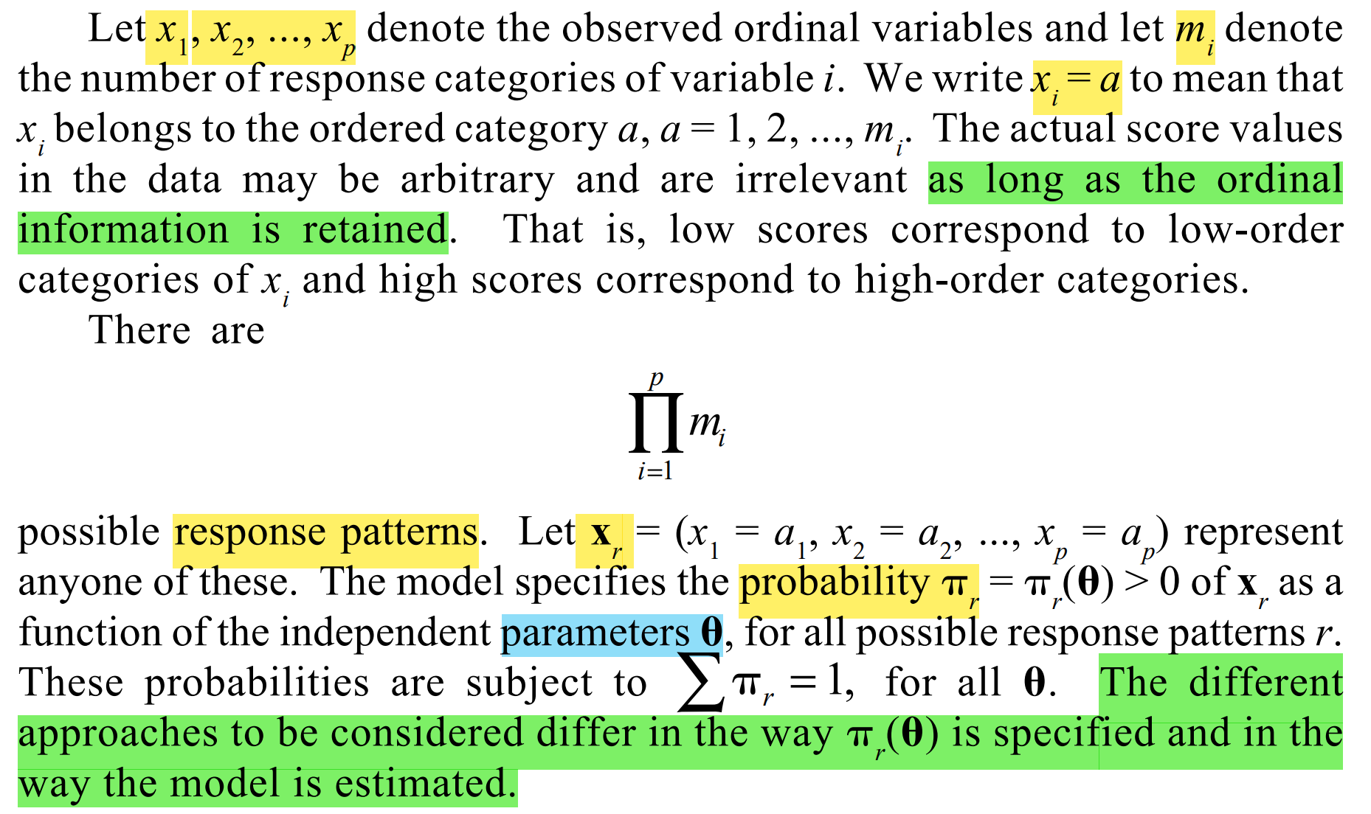
General Framework
Response pattern
Expected probability of the response pattern

Slide 12
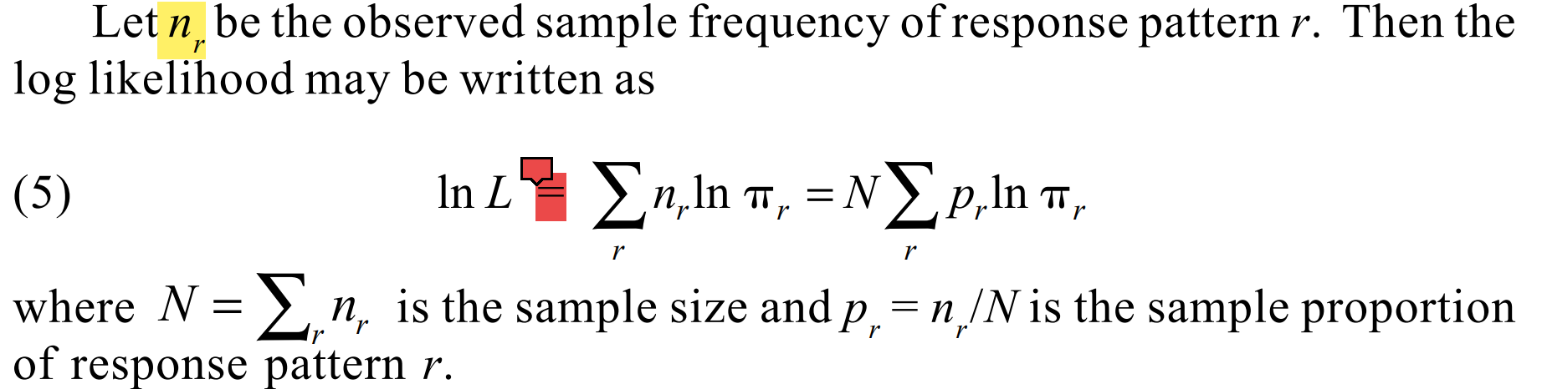
Maximum likelihood method

Slide 13
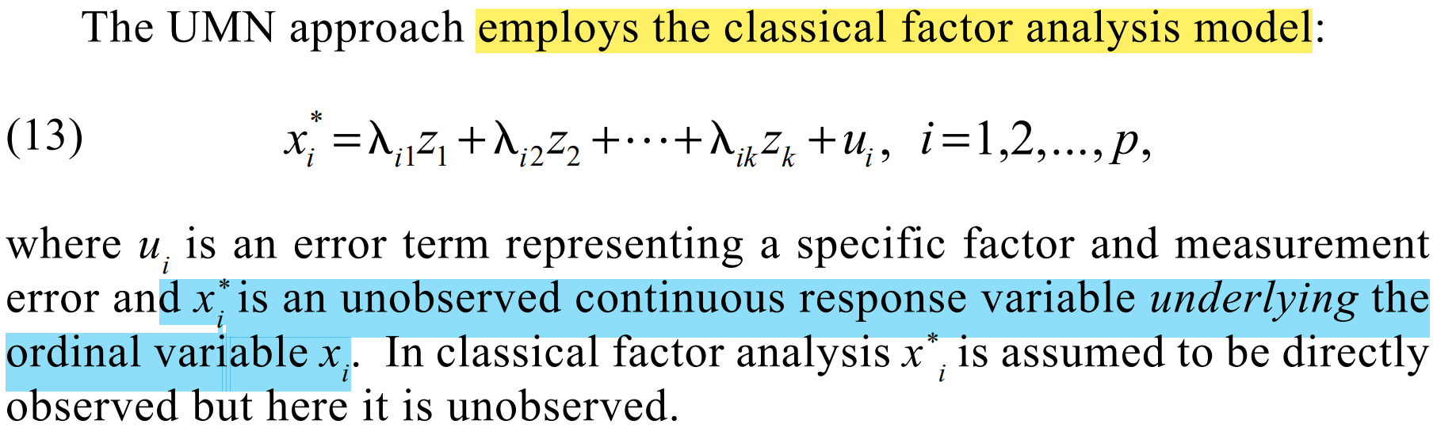
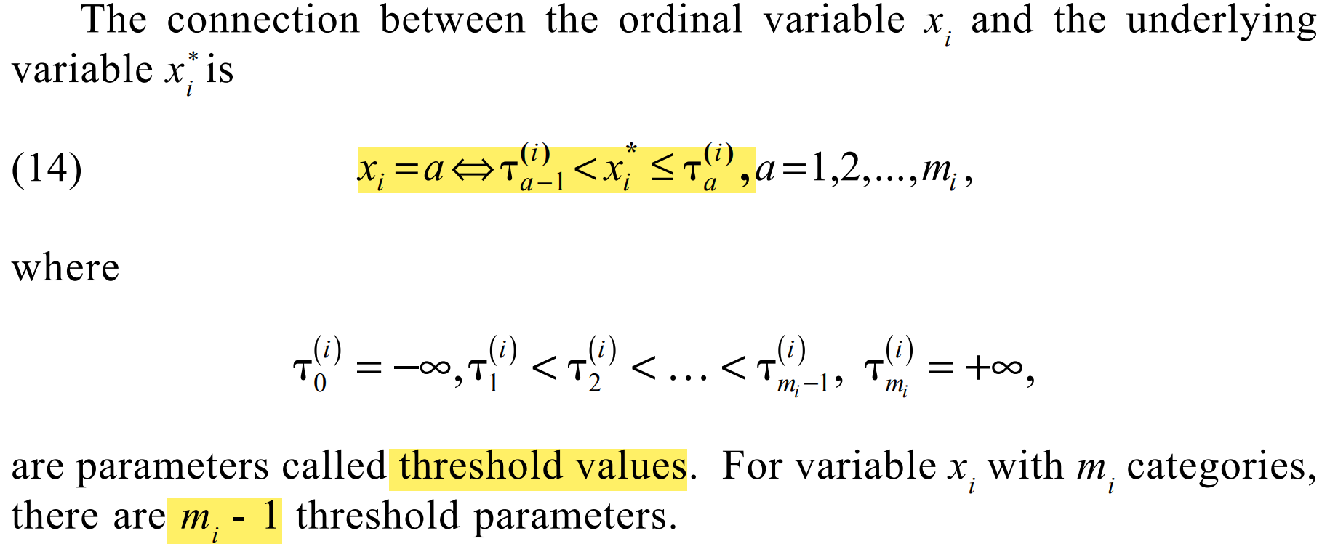
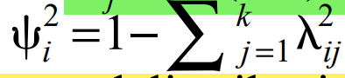
UMN
X_i* standard normal

Slide 14
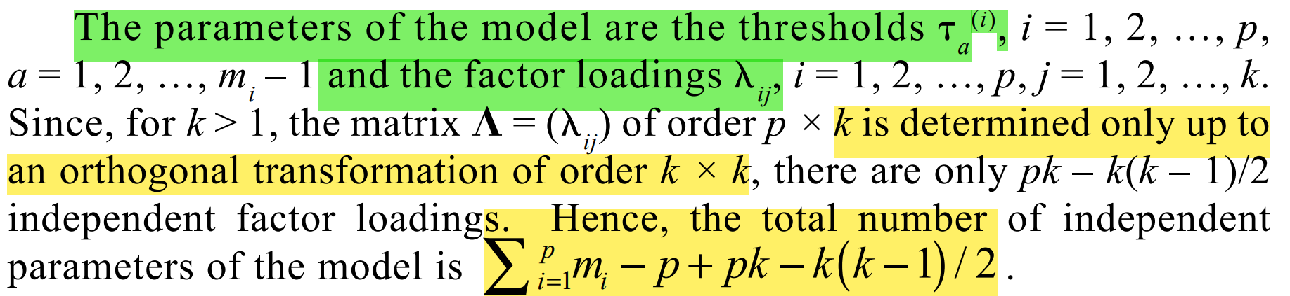
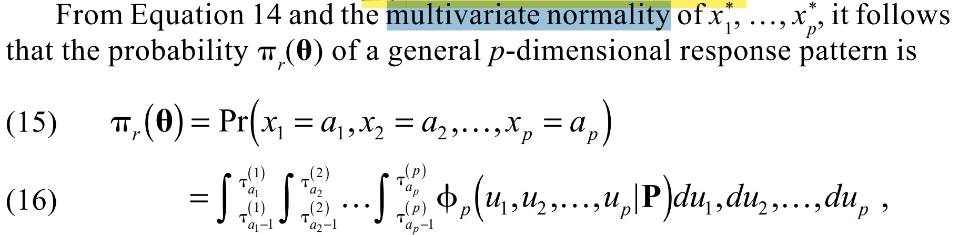
full information method

Slide 15
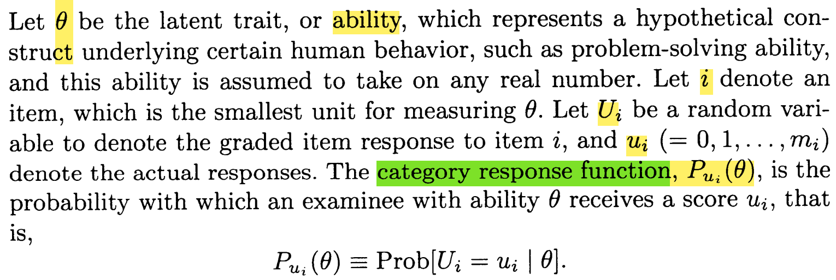
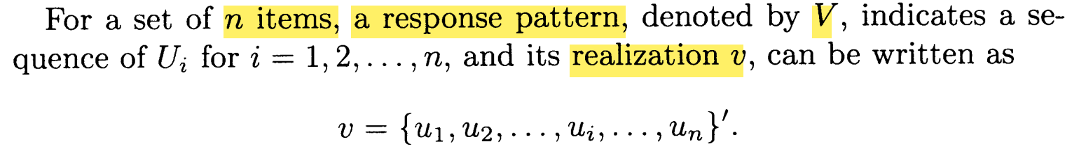
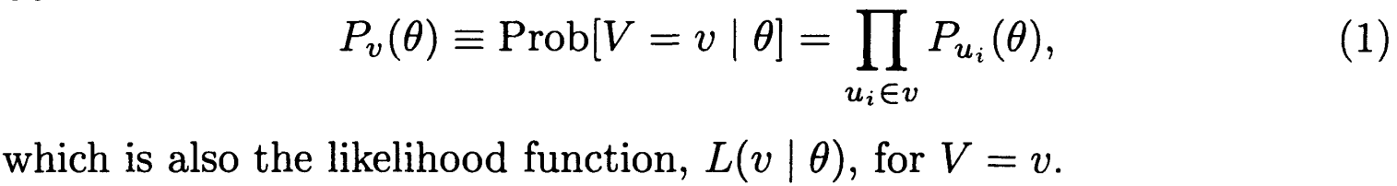
IRT
local independence

Slide 16
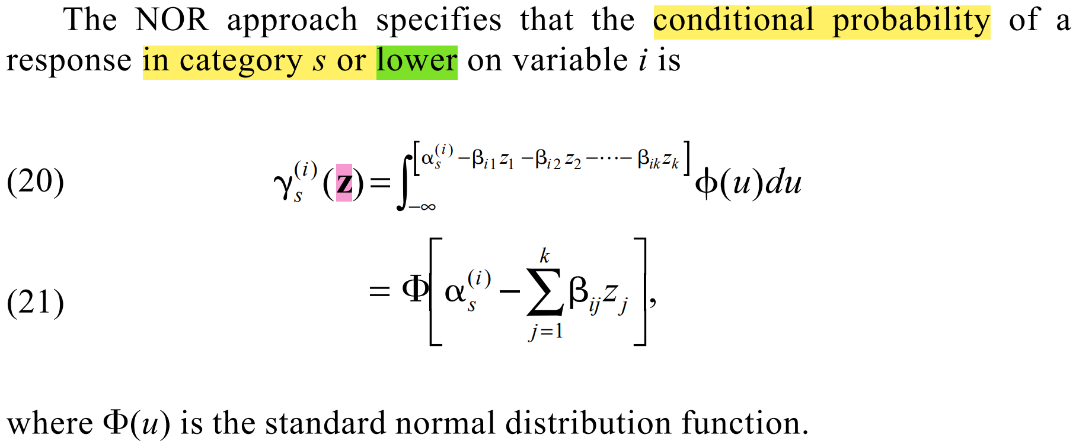
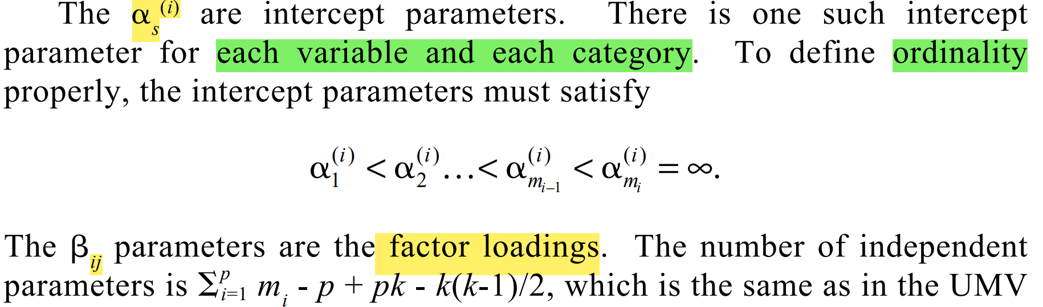
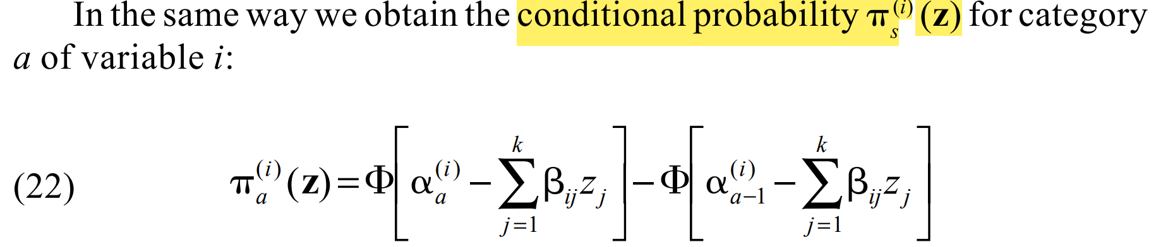
NOR
cumulative response function
category response function

Slide 17
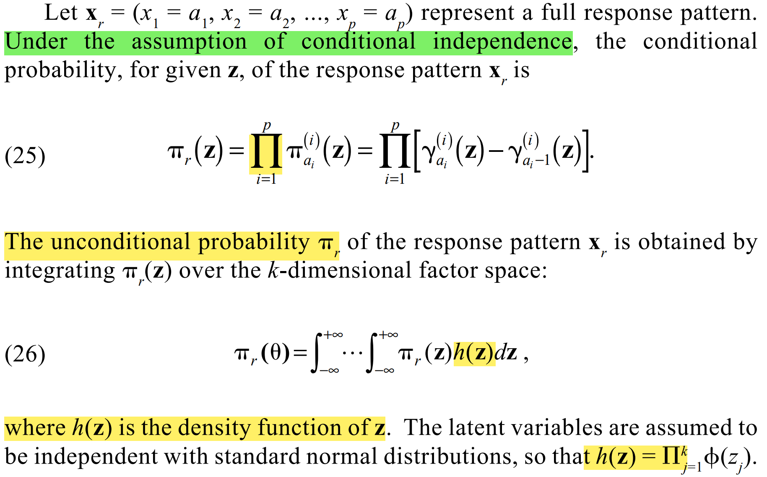

Slide 18
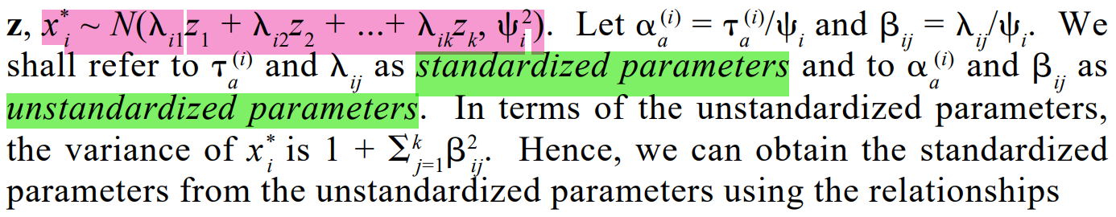
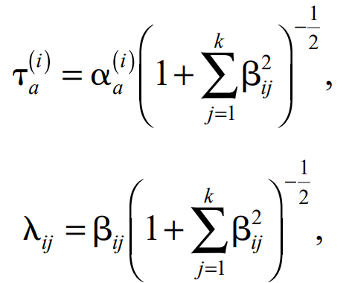
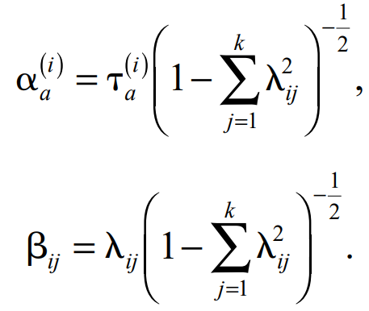
Connection

Slide 19
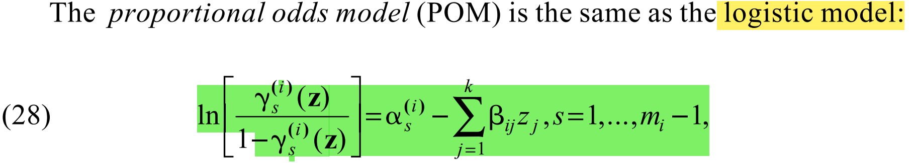
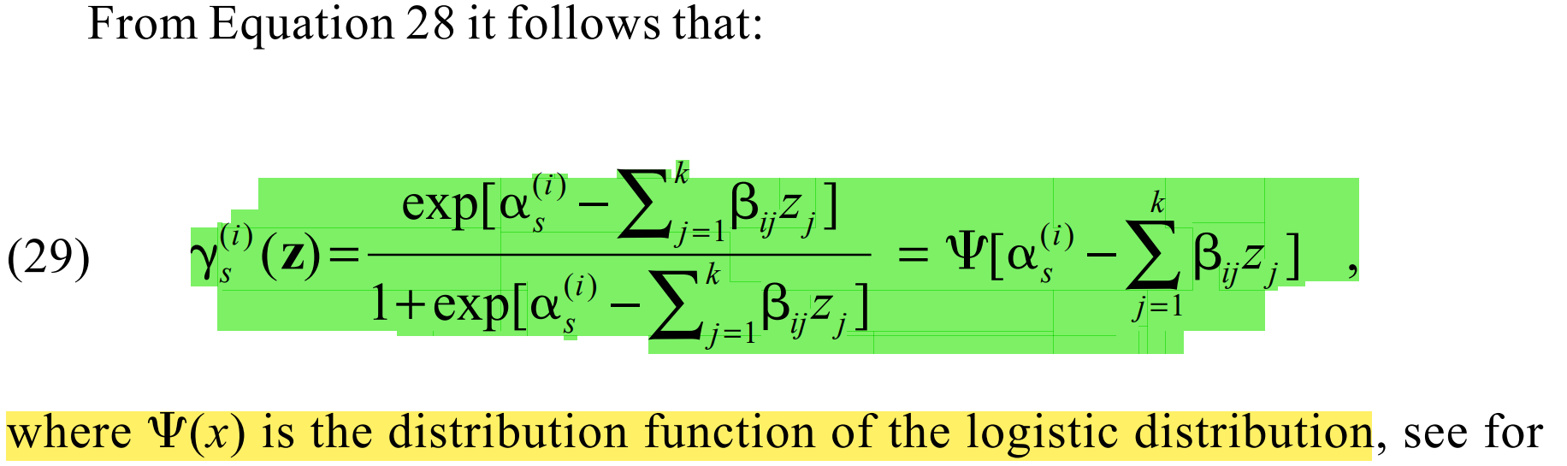
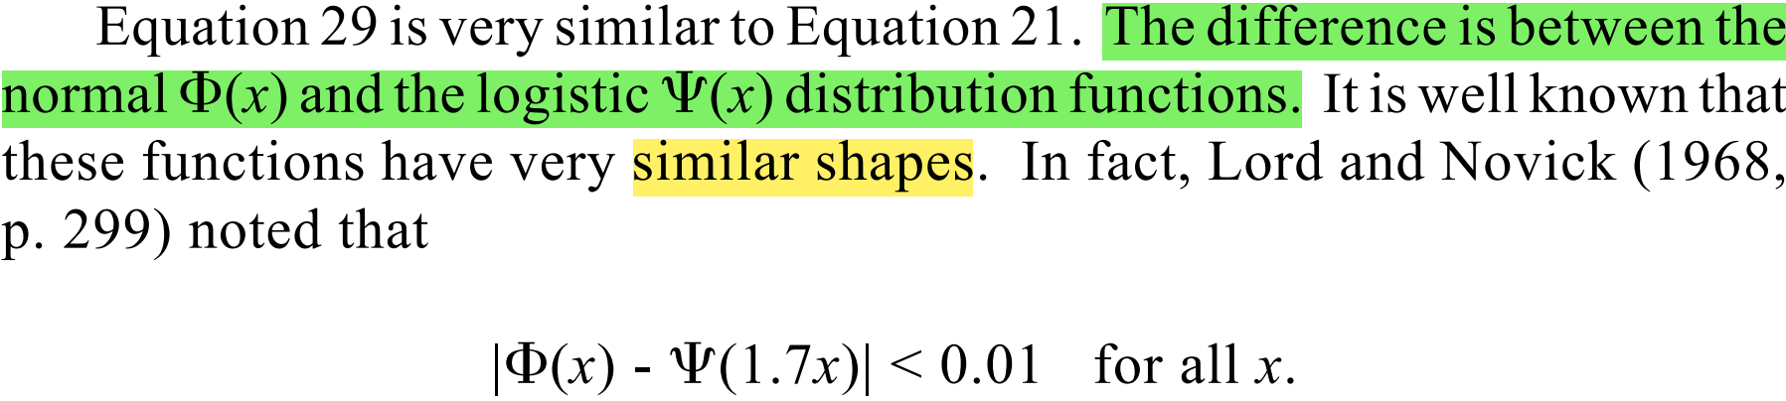
POM

Slide 20
Goodness of fit
Model fit: Reduced M2( when the p-value is greater than .05);
RMSEA( when the confidence interval covers or is below .05);
CFI; TLI.
Person fit: whether the individual response pattern align with the model. If less than 5% of the respondents have higher or lower infit and outfit values than 1.96 and -1.96, we are good.
Item fit: how well each item fits the model. (generalized S-X2 statistics).
LD: violations may point toward the presence of subscales. (G2 LD index)

Slide 21
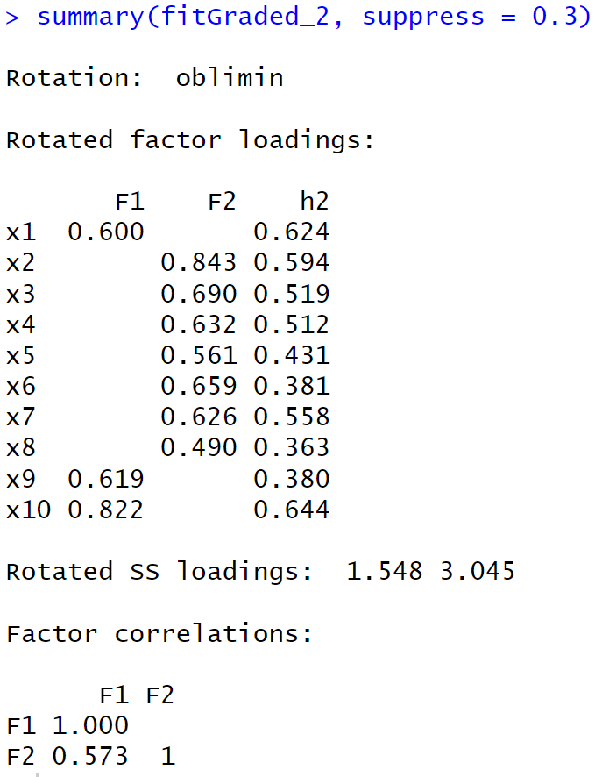
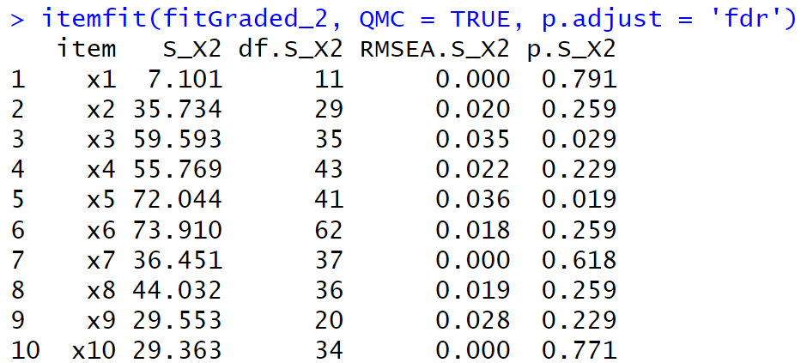



Slide 22
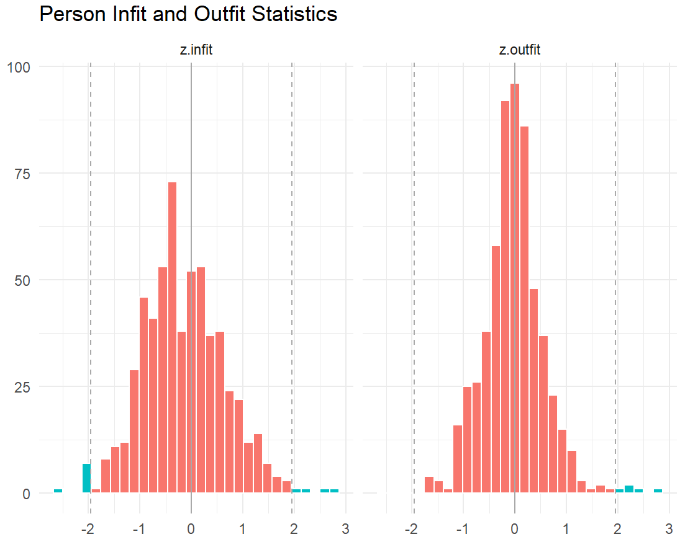
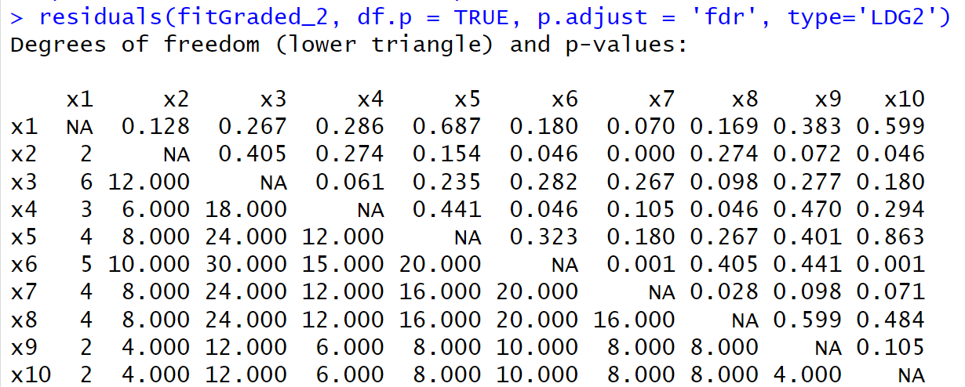









Slide 23
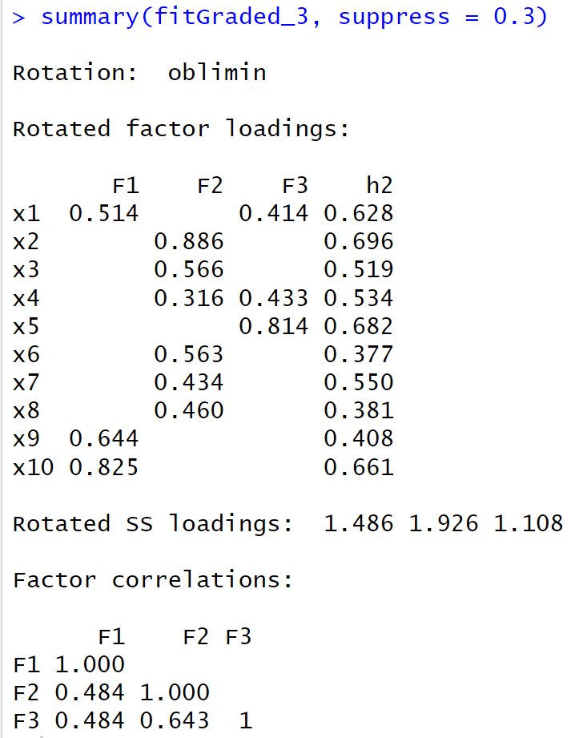
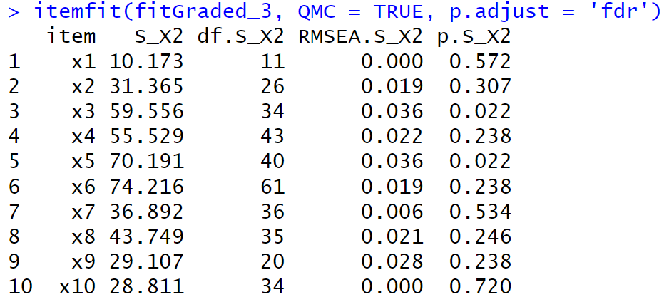



Slide 24
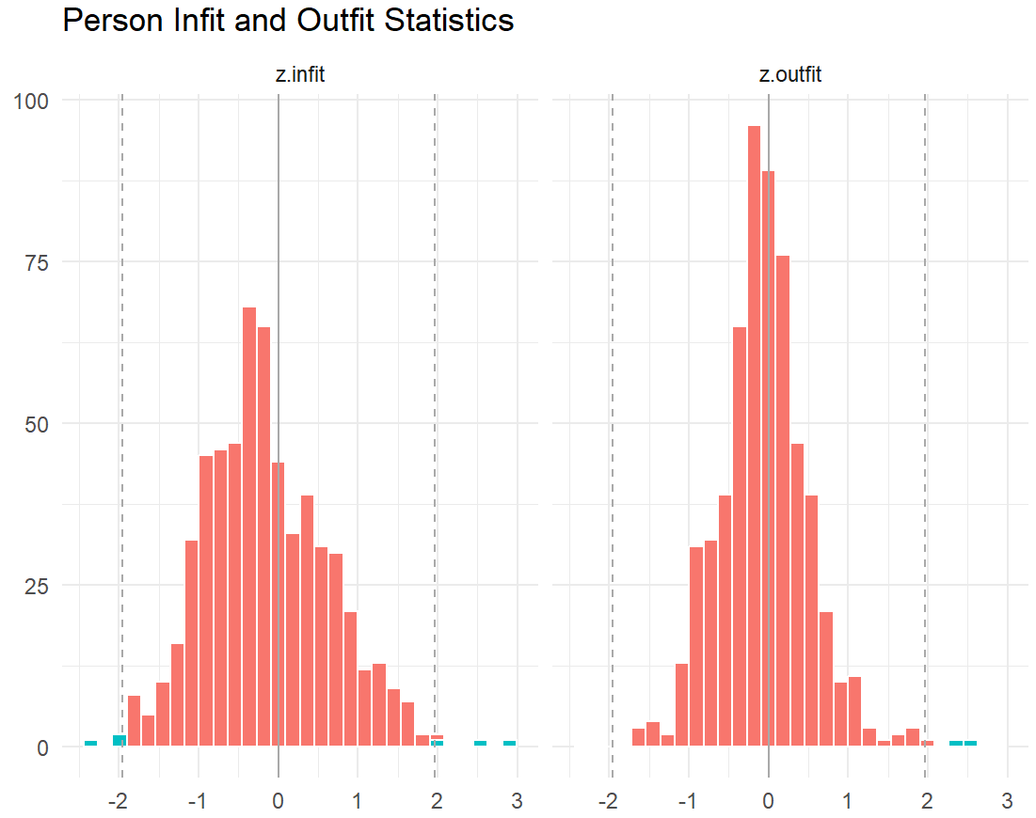
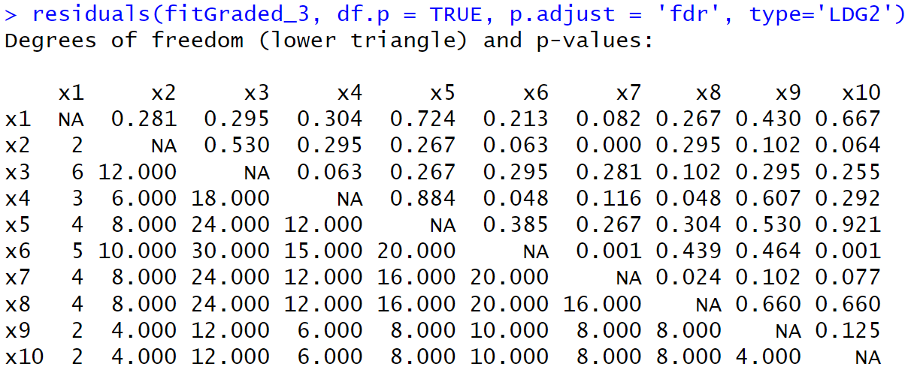







Slide 25
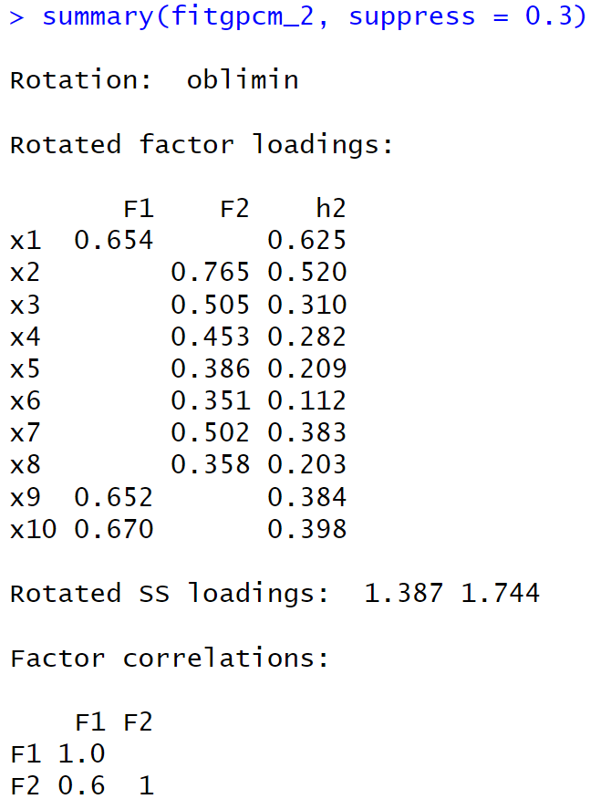
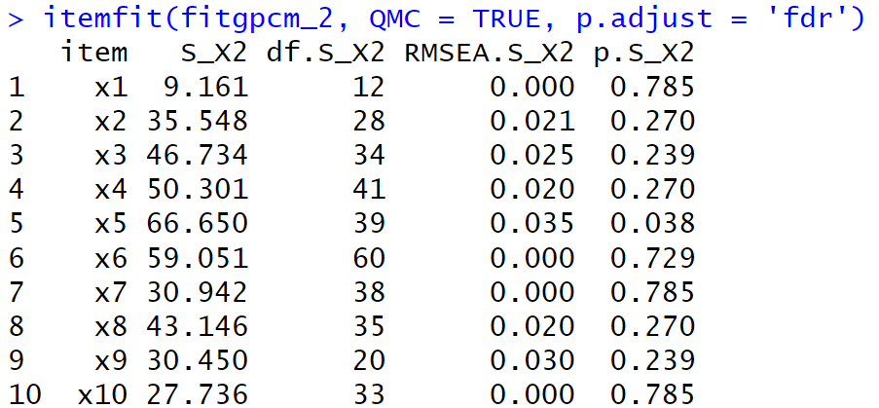


Slide 26
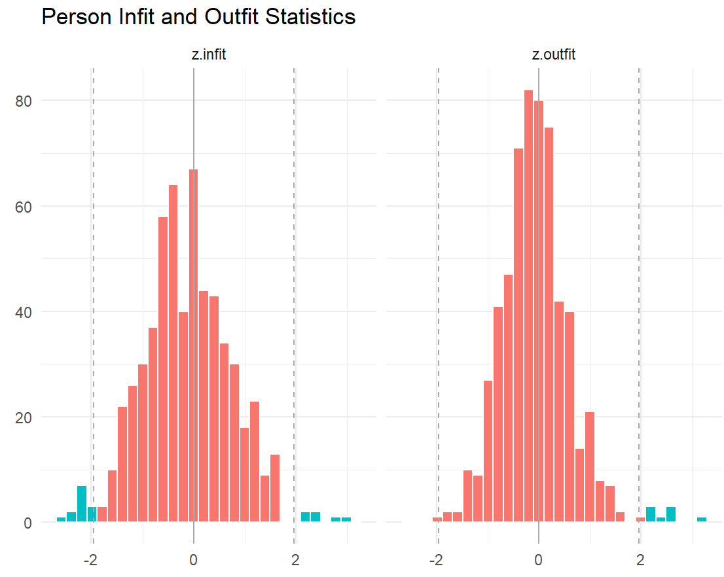
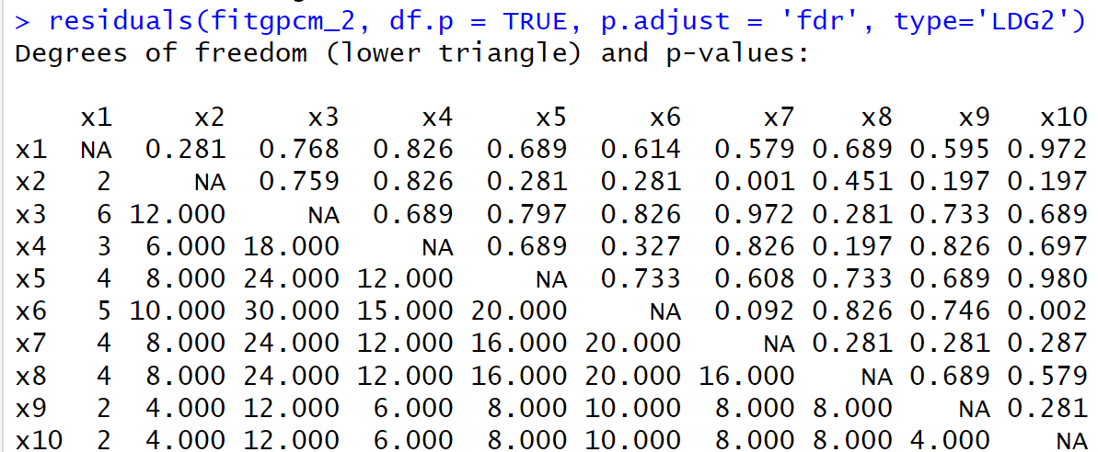



Slide 27
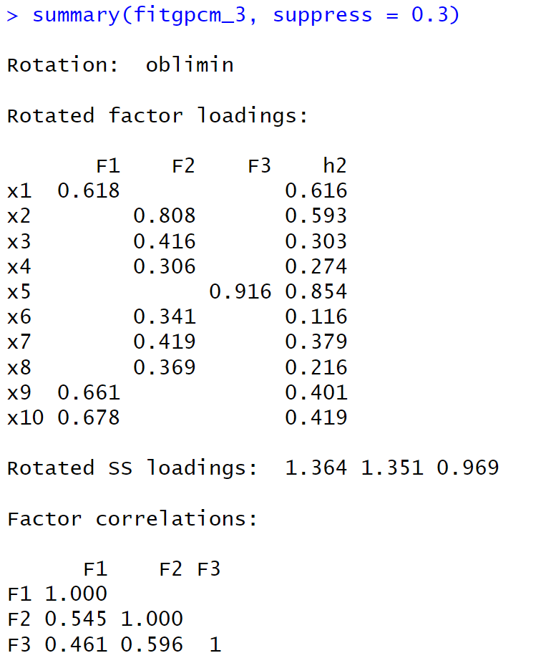



Slide 28





Slide 29















Slide 30

Papers

Slide 31

















2005

Slide 32



2012_Freitas_ related validity
2014_Freitas_Rasch_1
2015_Freitas_Rasch PCM_1

Slide 33



2020_Japan_EFA_CFA

Slide 34



Slide 35

Further

